Slide 1

PYTHON MINI PROJECT
TAWFFEQA U

Slide 2
Project Introduction
Objective:
Clean an unclean sales dataset.
Handle missing values.
Correct invalid values.
Convert datatypes.
Prepare the dataset for analysis.

Slide 3
Dataset Details
Dataset Type:
Sales Data Rows: 20,000
Columns: 6
Data Type: Sales
Data File Format: CSV

Slide 4
Tools & Libraries Used
Pandas
NumPy
Jupyter Notebook

Slide 5
Data Cleaning Workflow
Load Dataset
↓
Check Data
↓
Find Missing Values
↓
Correct Invalid Values
↓
Convert Data Types
↓
Fill Missing Values
↓
Final Clean Dataset

Slide 6
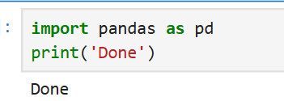
Import Pandas
Explanation :
Imported the Pandas library for data handling and cleaning.
print("Done") confirms the library was imported successfully.

Slide 7
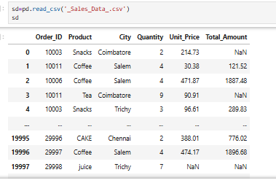
Load the
Dataset
Explanation :
Loaded the sales dataset using pd.read_csv().
Stored it in the variable sd

Slide 8
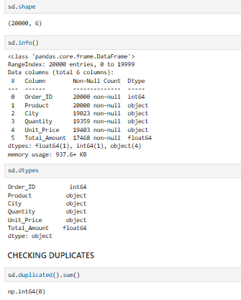
Dataset Info
Explanation :
sd.shape
Checks dataset size (rows & columns).
sd.dtypes
Checks column data types.
sd.duplicated().sum()
Counts duplicate rows.

Slide 9
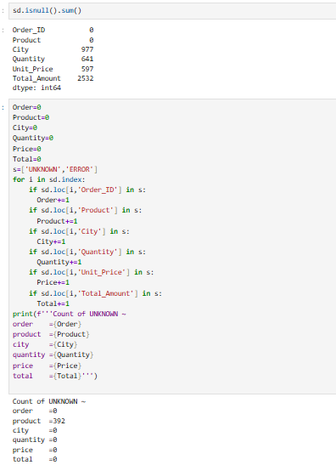
Checking null and
Wrong Values
Identified missing values in
each column
And counting null and Unknown
values

Slide 10
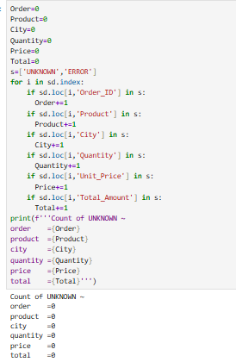
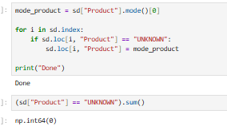
After replacing values
Found UNKNOWN values in the
Product column.
Replaced them with the most
frequent product by (mode)

Slide 11
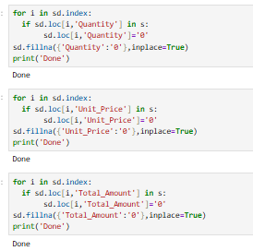
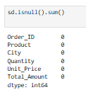
Replacing wrong and
null values with 0
Count after replaced

Slide 12
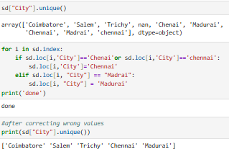
Standardizing City Names
Checked unique city names using unique().
Corrected inconsistent city names (e.g., chennai → Chennai,
Madrai → Madurai).
Verified the updated city names using unique().

Slide 13
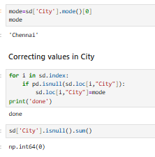
Handling Missing Values in City
Found the mode of the City column.
Filled missing city values using the mode.
Verified that no missing values remained.

Slide 14
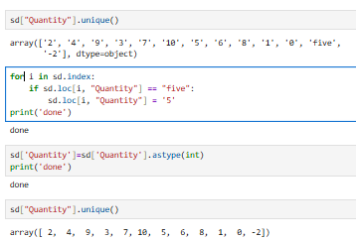
Cleaning the Quantity Column
Checked unique values in the Quantity column.
Replaced invalid text values (e.g., five → 5).
Converted the Quantity column to integer datatype.
Verified the cleaned values.

Slide 15
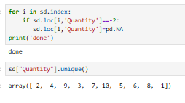
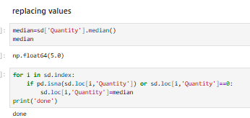
Handling Negative and
Missing Values
Converted negative values to Null.
Calculated the median of the Quantity column.
Replaced missing and 0 values with the median.
Verified the cleaned Quantity values.

Slide 16
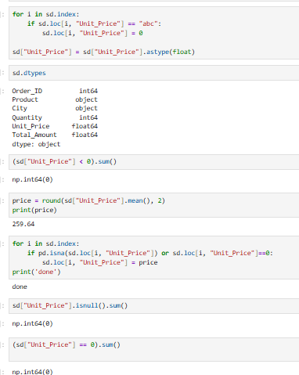
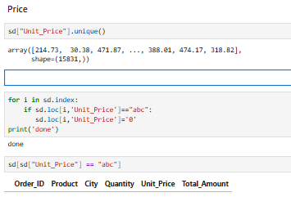
Cleaning the Unit Price Column
Checked unique values in the Unit_Price column.
Replaced invalid values (abc) with 0.
Converted the Unit_Price column to float datatype.
Checked for negative values.
Calculated the mean of the Unit_Price column.
Replaced missing and 0 values with the mean.

Slide 17
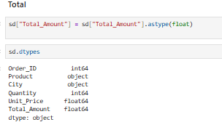
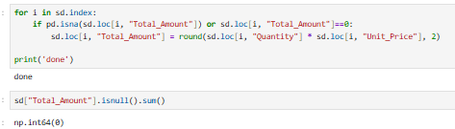
Cleaning the Total Amount Column
Converted the Total_Amount column to float datatype. Calculated the mean of the Total_Amount column.
Replaced missing and 0 values using Quantity × Unit_Price. Verified that no missing values remained.

Slide 18
Saving the Cleaned Dataset
Saved the cleaned dataset as a new CSV file.
index=False prevents row index numbers from being saved.

Slide 19
Validation
Checked missing values
Verified data types
Verified duplicate records
Confirmed cleaned dataset

Slide 20
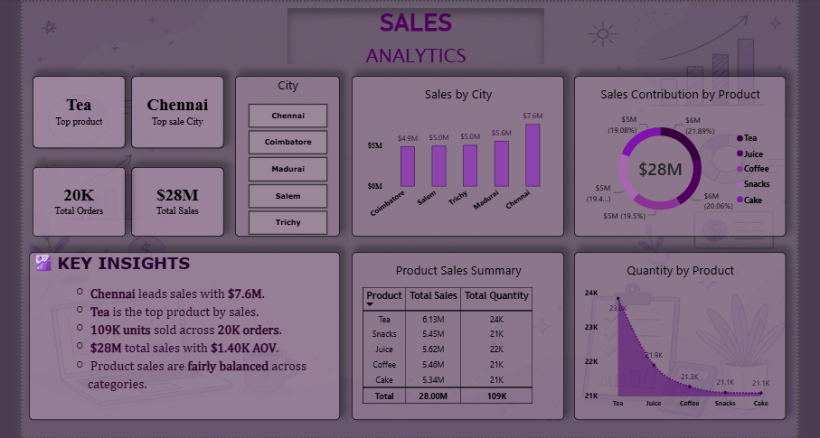

Slide 21
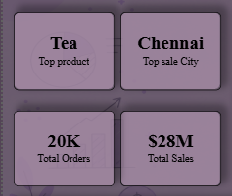
Key Performance Indicators
Total Sales – Overall revenue generated
Total Orders – Number of orders received
Top Product– Highest Products sold
Top Sale City– Finding the top sale in city

Slide 22
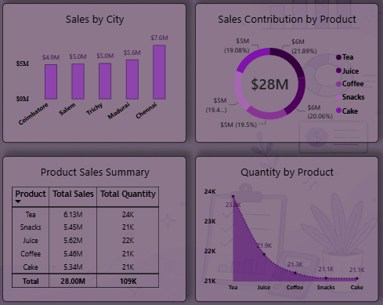
Key Areas Covered
Sales by City
Shows total sales generated by each city.
2.Sales Contribution by Product
Shows how each product contributes to total sales.
3.Product Sales Summary
Summarizes total sales and quantity sold for each product.
4.Quantity by Product
Compares the quantity sold across different products.

Slide 23
Conclusion:
Successfully cleaned the sales dataset.
Corrected missing, invalid, and inconsistent values.
Converted columns to appropriate data types.
Saved the cleaned dataset for further analysis.
And also prepared meaningful insights.

